Slide 1

Artificial Intelligence in Finance at Hong Kong University of Science and Technology
Notes:
What does “greedy” refer to for “greedy algorithm”?
Optimal at the current step
Monetary reward gained in the training process
Binary splitting using neural networks
None of the above
What happens when there are too few steps of splitting in a tree?
Large bias, large variance
Large bias, small variance
Small bias, large variance
Small bias, small variance
In a decision tree, if the current split is ineffective, future splits can still be effective (even very effective).
True
False
Which of the following are usually used to evaluate the quality of a split in a classification tree?
Gini-index and splitting bias
Cross-entropy and splitting bias
Gini-index and cross-entropy
All of the above
Which of the following is true about bagging?
Works best for high variance and high bias learning methods
Works best for high variance and low bias learning methods
Works best for low variance and high bias learning methods
Works best for low variance and low bias learning methods
Which of the following is true about boosting?
A combination of many weaker learners to produce a strong learner.
Weaker learners are usually created in parallel.
Boosting is only applicable for classification problems.
None of the above

Slide 2
www.slido.com
#UST

Slide 3
Final Assignment & Presentation
NO exam
Final assignment (group) in the form of an eight (8)-page report based on the NIPS format documenting:
Progress and learning from group project (technical report)
Reflection on an AI article and a finance one (essay)
Synthesis and suggestions for further study
Note individual contribution
Final presentation (group) in short YouTube videos (10 mins)
Peer review for both final assignments and final presentations
Due date: May 26, 2019 (Sunday)
Note: Details may change depending on class progress as well as feedback and policy of HKUST.

Slide 4
Class Schedule
Date | Topic | Presenters
Apr 26 | Introduction to Unsupervised Learning Cases Studies, Industry Primers & Logistics | Prof. Yao Anthony Woo
May 3 | Investment Trends & FinTech Outlook | Mr. Christopher Lee Anthony Woo
May 10 | Tutorial | Yifei Huang
May 17 | Concluding Remarks | Prof. Yao Anthony Woo
Note: Details may change depending on class progress, development of relevant technologies, as well as information and feedback from students’ surveys.

Slide 6
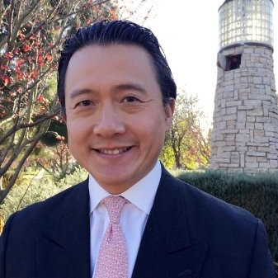



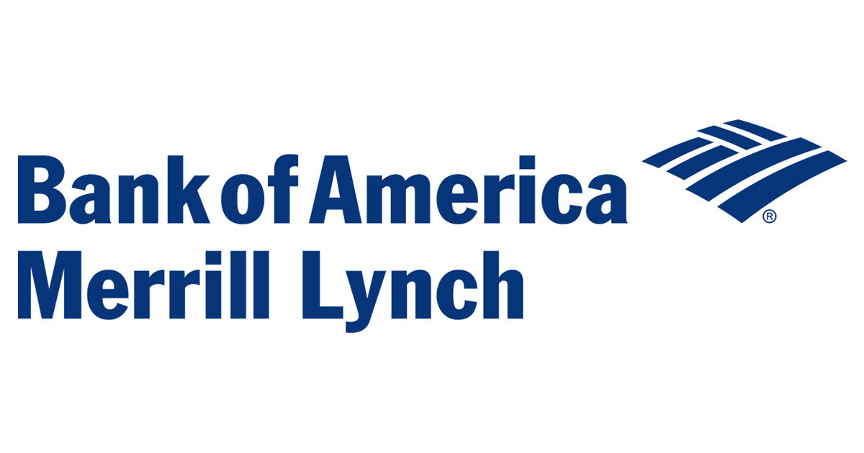




Investment Trends & FinTech Outlook Mr. Christopher Lee • May 3, 2019 • 7:30pm • HKUST Lecture Theatre E
M.Sc. in Financial Mathematics: AI in Finance
Mr. Chris Lee is a partner at FAA Investments, a private investment group focusing on real estate, early stage companies and in-depth research on hedge funds and private equity managers, with home bases in San Francisco and Hong Kong.
He is an advocate of sustainable enterprises and environmentally conscious projects, serving on various boards with a passion for promoting education, conservation, energy efficiency and sustainability. Chris also serves on the boards of UC Berkeley-Haas Dean’s Advisory Circle, African Wildlife Foundation, Hong Kong Securities and Investment Institute and Salzburg Global Seminar.
Academically, Chris is an associate professor of science practice at HKUST and teaches financial mathematics and risk management courses. He completed the AMP at Harvard University and holds a BS in Mechanical Engineering and an MBA from the University of California, Berkeley.
Additionally, Chris is a board director with expertise in financial markets, risk management, governance and leadership development. Currently, he serves as an Independent Board Member with Matthews Asia Funds, the largest US Investment Company (’40 Act) with a dedicated focus on Asia Pacific markets and The Asian Masters Fund Limited, an investment company listed in Sydney, Australia.
Previously, Chris was an investment banker for 18 years, acting as Managing Director and divisional & regional heads at Deutsche Bank AG, UBS Investment Bank AG and Bank of America Merrill Lynch. He worked in global capital markets, managed derivative product development and provided equity sales & trading functions to institutional investors.

Slide 7
Consultative Session: Tips & Best Practices
Because it is a company internship, you are held accountable to corporate standards (US standards, to be specific)
Not mandatory, but “highly recommended”
Same for company meetings, which range from “DS Co. Daily Update” to “Alibaba Annual Meeting”
If you cannot attend, ask your teammates to talk on your behalf
Be concise, clear, and straight-forward. Talking more does not mean a better result
There may be team members who are not very eloquent or articulative, you get points for helping each other. In fact, you both get points, so it is a “win-win”
It is a dialogue and a discussion. No one knows what the “true” answer is, so having some sense of the right direction matters more than what is right vs. wrong
There will be more of these sessions, so stay tuned
Because it is a company internship, you are held accountable to corporate standards
Not mandatory, but “highly recommended”
Same for company meetings, which range from “DS Co. Daily Update” to “Alibaba Annual Meeting”
If you cannot attend, ask your teammates to talk on your behalf
No one knows what the “true” answer is, so having some unified direction matters more than what is right vs. wrong
Be concise, clear, and straight-forward. Talking more does not mean a higher score
There may be team members who are not very eloquent or articulative, you get points for helping him or her (in fact, you both get points, so it is a “win-win”)
There will be more sessions; some may ask whether the consultative sessions are mandatory, the real answer is yes and no… possibly “passively-mandatory”

Slide 8
Beyond the Classroom

Slide 9
Beyond the Classroom
Session | Date | Topic
3 | Feb 22 | HireVue: Recruiting & AI
4 | Mar 1 | Company Research: Bloomberg, McKinsey Insights, Zero2IPO
5 | Mar 8 | PowerPoint Creation
6 | Mar 15 | CV Writing & Interview Preparation
7 | Mar 22 | Certifications (CFA, CPA, GMAT…)
Session | Date | Topic
8 | Mar 29 | LinkedIn & Networking
9 | Apr 12 | Industry Primer: Investment Banking
10 | Apr 26 | Industry Primer: Management Consulting
11 | May 3 | Industry Primer: FinTech & VC/PE
12 | May 10 | Presentation Skills

Slide 10
www.slido.com
#UST

Slide 11
Questions from China Construction Bank
A lot of Fintech aim at disrupting the Banking industry, what kind of Fintech can a bank in Hong Kong implements without hurting its current position?
What is the difference between Fintech and Information Technology in Banking?
As your example of Alibaba, is fintech must rely on Big data
What is the difference between big data and traditional statistics science which has been doing complicated models for decades?
You recommend the Bank should develop own FinTech or rather cooperate with FinTech company？
What are the challenges of Virtual banking in HK that you will foresee? What do you think about the successful case of the Tangerine Bank in Canada?
Compare to Singapore and China, what is the competitive edge do HK possesses?
Do you think Fintech is over-valued by the business and will it be just like a bubble effect?
Among these 5 processes in your AI implementation matrix, which one would be the easiest to implement? What should be the priorities?
Do you have any AI implementation roadmap recommendations for CCBA? What area can implement AI first?
Which fintech category/ product you think is the most attractive and valuable for us to make investment?
Any successful case for robotics investment?
AI is a learning engine thru trials and errors. Can the banks really tolerate on such errors during its implementation? High operational or reputation risk?
Which fintech category/ product you think is the most attractive and valuable for us to make investment?
From your adversary example, what is your view in face recognition (like Alipay 刷臉支付) application, can it be manipulated by somebody to misuse this?
Any potential use of AI to assess loan product / mortgage serviceability?

Slide 12



Corporate finance and valuation
External financial experts focusing on forward-looking elements
Credibility in asset management and equity research
Useful for networking, as circle is small
Alternative investments (VC • PE • HF)
Include commodity, real estate, derivatives etc.
Buy-side (e.g. pension funds, family offices, foundations)
Useful for networking, as circle is very small
More quantitative elements, but still manageable from MAFS perspective
Risk management and compliance
Useful for networking in middle-to-back-office positions, as circle is very small

Slide 13




Internal financial experts (e.g. financial control, auditing) focusing on historical financials
Almost a must to rise in ranks within an accounting firm
Useful for a CFO role at a large company (e.g. Fortune 500)
Lack of authority to explain at length about these two
10-hour, self-paced e-learning course that provides an interactive introduction to the financial markets
5 modules: Economic Indicators, Currencies, Fixed Income, Equities, and Getting Started on the Terminal

Slide 14
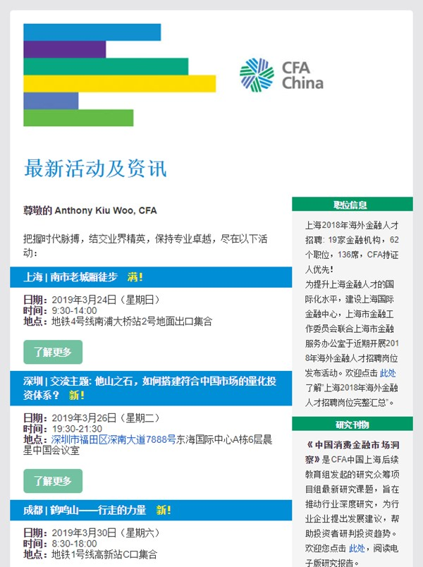
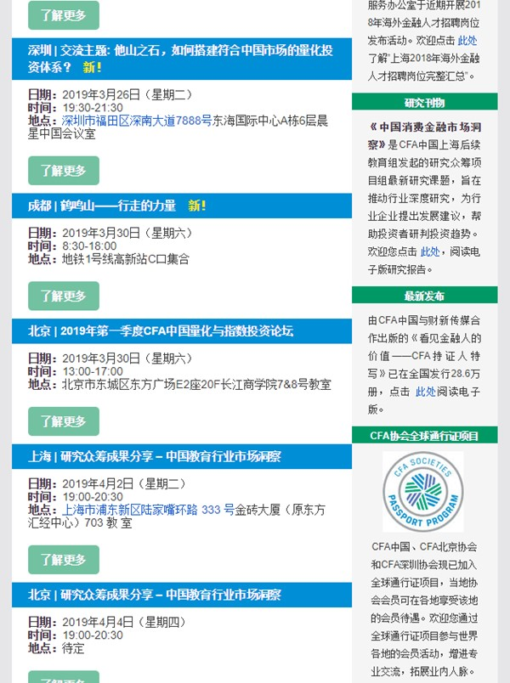

Slide 15
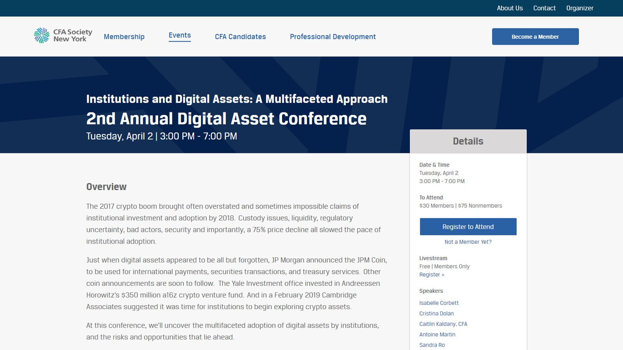

Slide 16
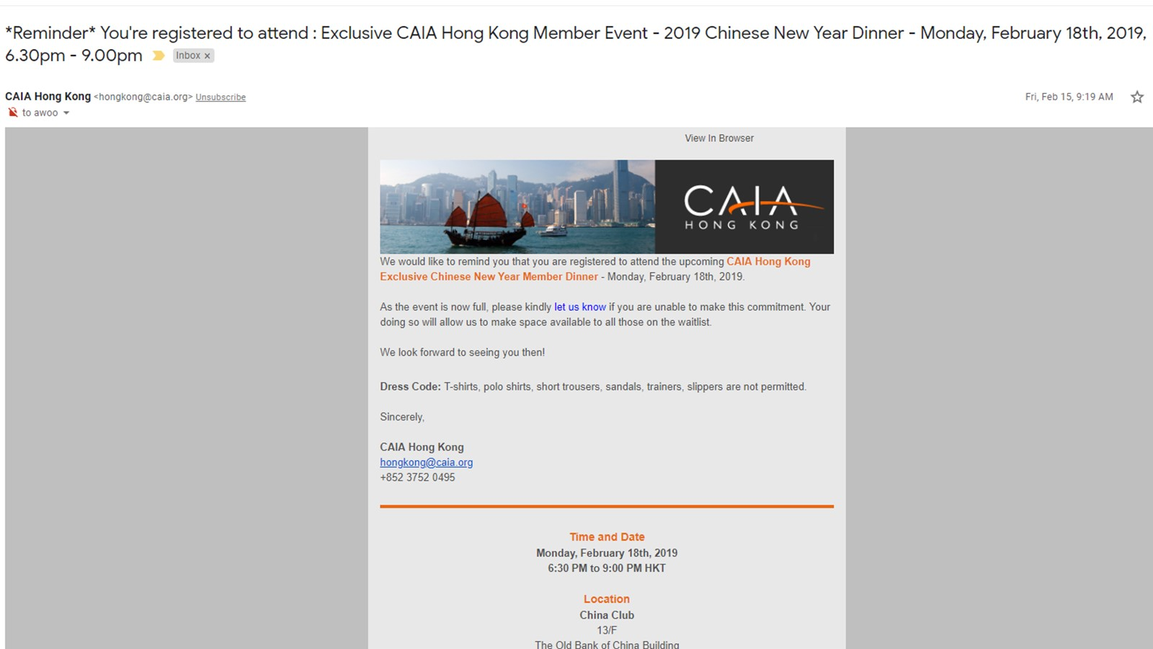

Slide 17
Internal financial experts (e.g. financial control, auditing) focusing on historical financials
Almost a must to rise in ranks within an accounting firm
Useful for a CFO role at a large company (e.g. Fortune 500)
Lack of authority to explain at length about these two
10-hour, self-paced e-learning course that provides an interactive introduction to the financial markets
5 modules: Economic Indicators, Currencies, Fixed Income, Equities, and Getting Started on the Terminal

Slide 18
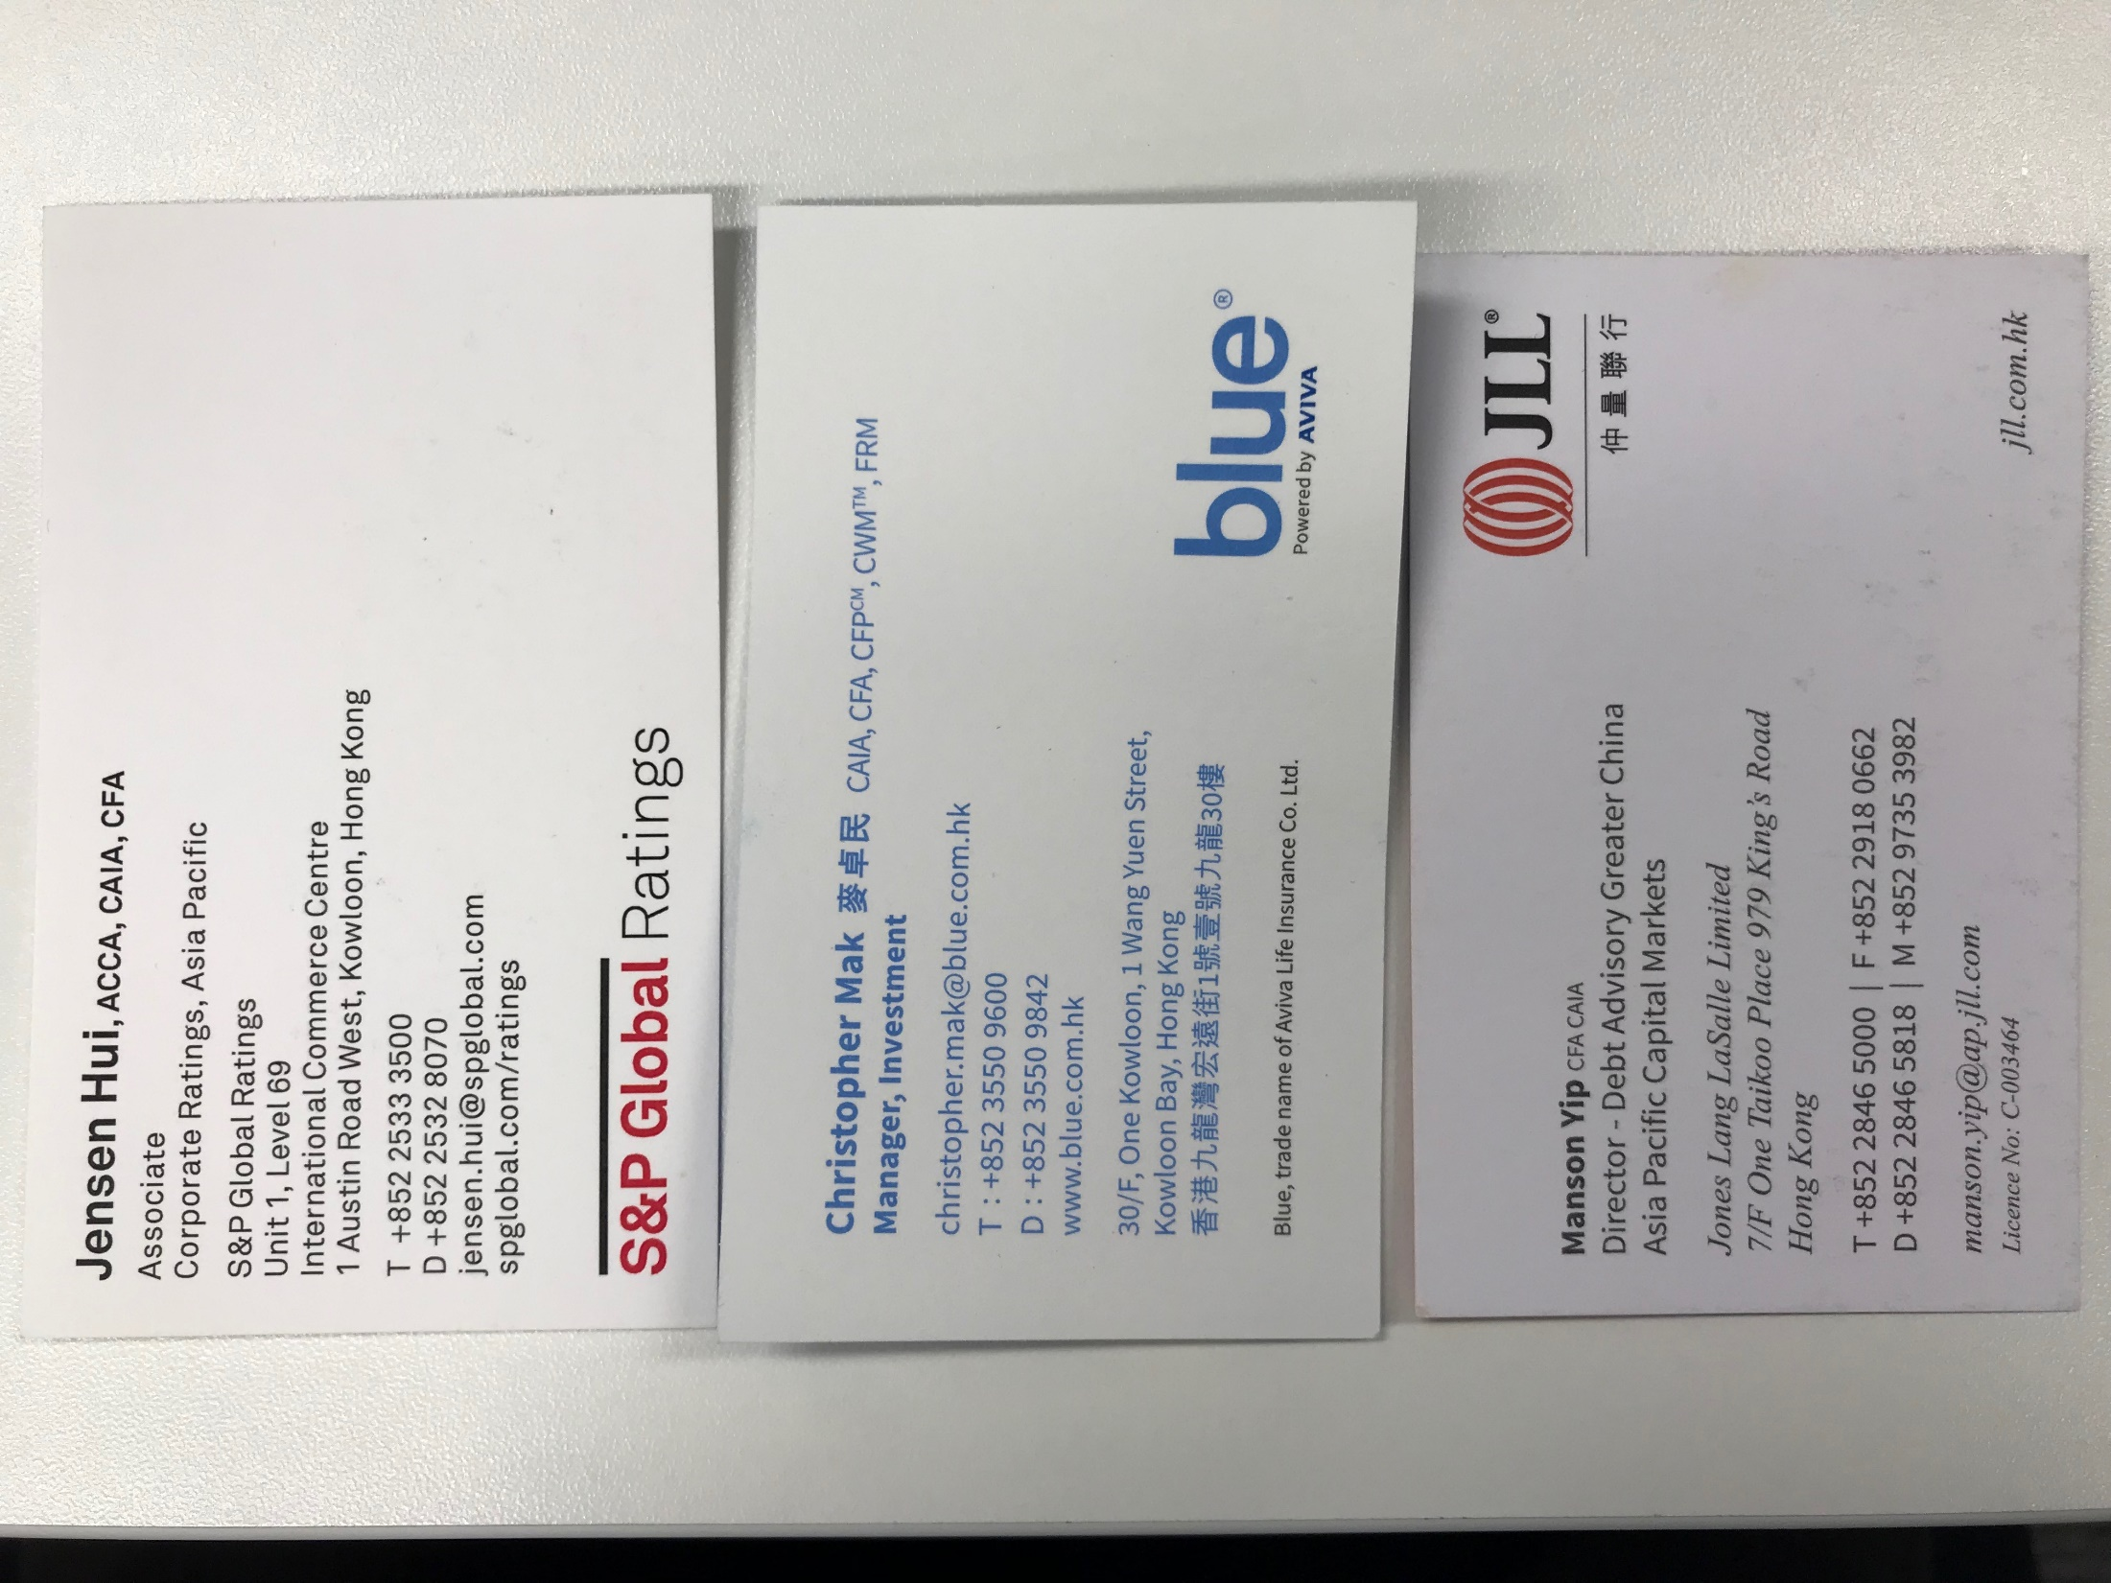
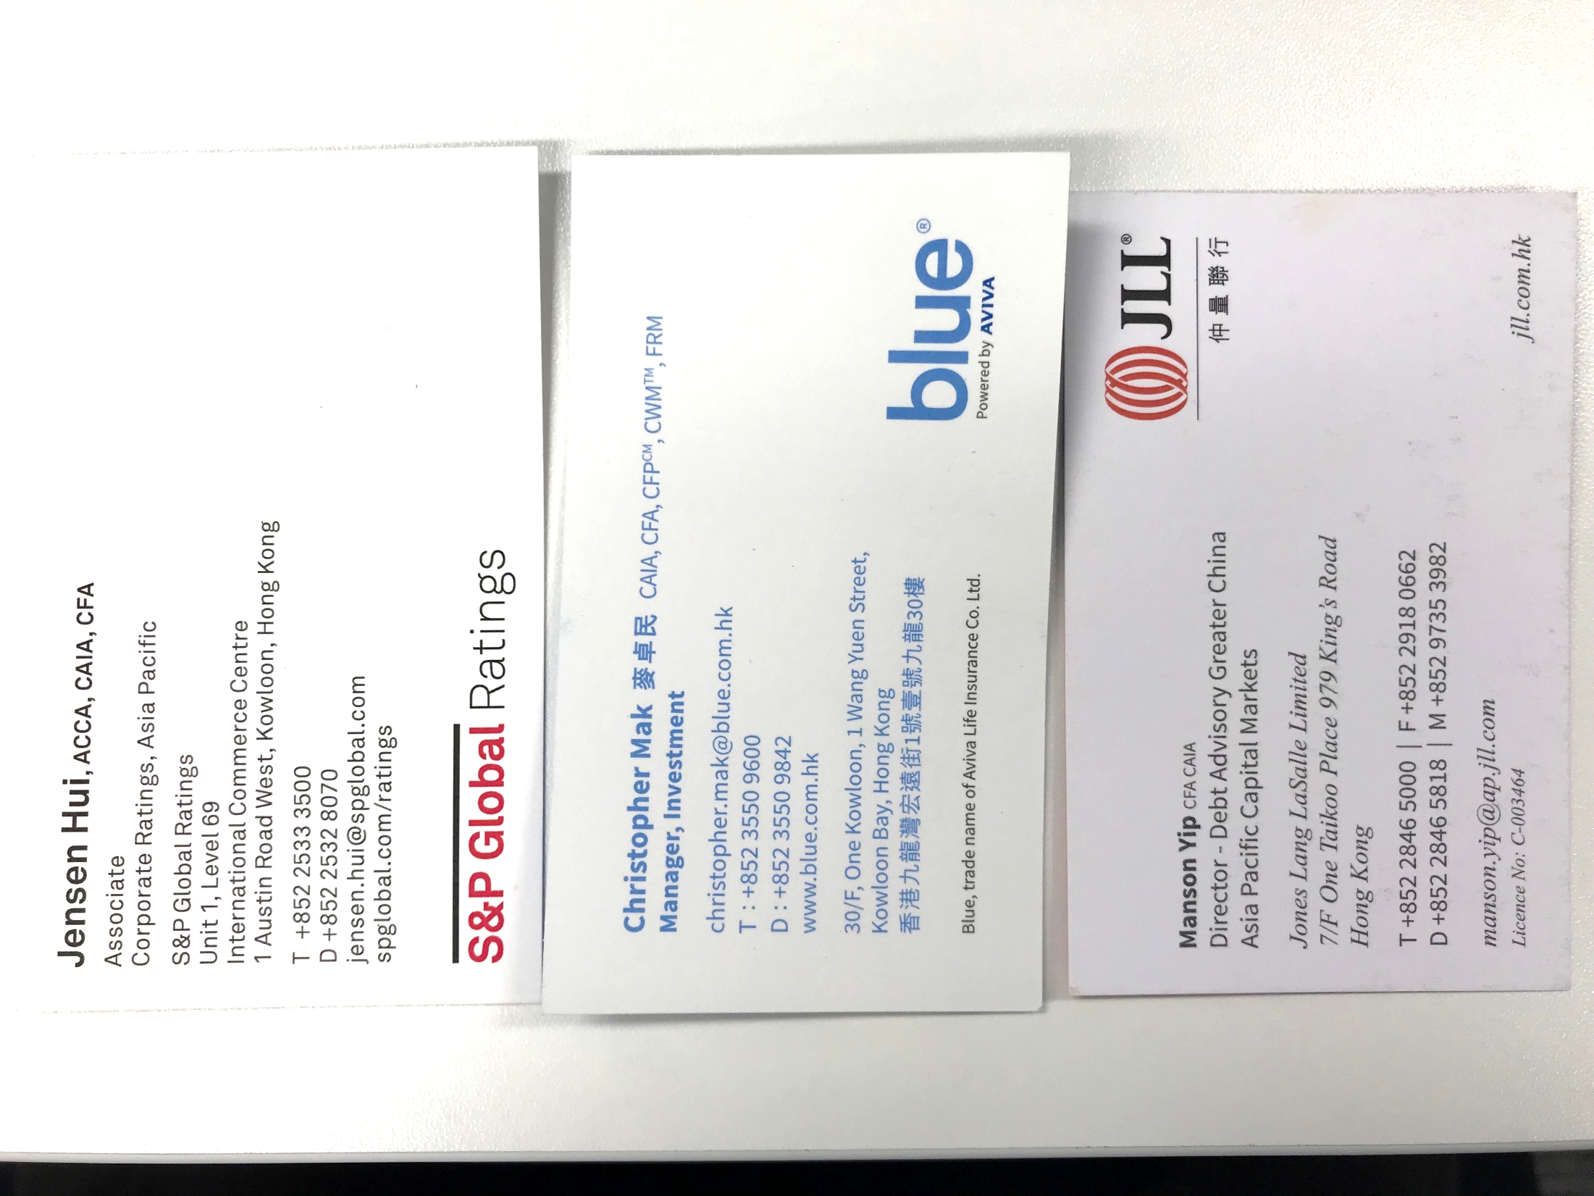




Slide 19
The Recruitment Process
Show face
Presence counts
Ask smart questions
A test of the “intangibles” (EQ)
Activities & Info-sessions
Resume & Cover Letter
Interview
Job Offer
Career Planning
What you want
Market questions
Technical questions
Company specific questions
General and behavioral questions
Name dropping
Can be a “hygienic” factor
Offer negotiation
“Strategy” vs. “Execution”
Trends and outlook

Slide 20
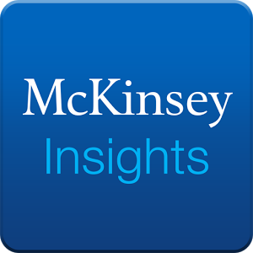




Resources for a Career in Finance
FinanceAsia (http://www.financeasia.com/)
Dealogic (http://www.dealogic.com/)
McKinsey Insights (http://www.mckinsey.com/insights)
清科集团：投资界 (http://www.pedaily.cn/)
Wind Financial Terminal

Slide 21
